Slide 1
Advanced Developmental Psychology
PSY 620P

Slide 2
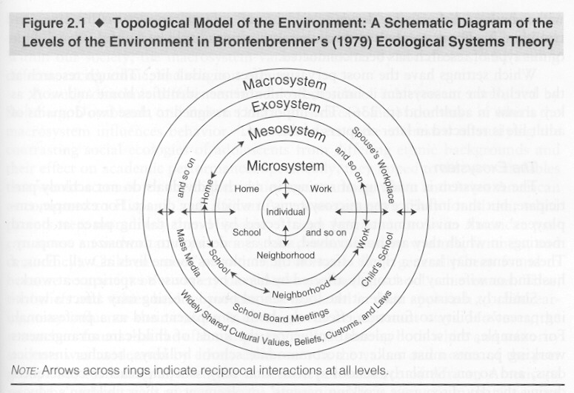
Socialization Processes
Parent-child relationships
Peer relationships
School and community influences
Classroom networks
School effects
Notes:
Children and adolescents spend more time in school than any other place outside home
Research typically conducted by educational psychologists and sociologists
Schools can promote competence or reinforce developmental difficulties

Slide 3
Classroom networks
Emergent group properties
Gender socialization
Network properties over time
Observed
Social networks and disabilities
Teacher reported homophily
Objective measures
Social contact, language, and disabilities
Messinger et al; Fasano et al
Network bulling interventions
Slide deck change
School belonging and school plays
Slide deck change

Slide 4
Social constructs
Interactions, relationships, and groups are mutually constitutive and have emergent properties
Concepts like popularity exist at an individual and group level
Networks are an attempt to capture the ensemble of social relationships
Social media, twitter, tik-tok, discord, Facebook
classrooms

Slide 5
Levels of analysis
Interactions
The braiding of two individual’s behavior
Relationships
“succession of interactions”
Friendship is a reciprocal, voluntary relationship based on affection
Groups – collection of interacting kids
Defined by cohesiveness, hierarchy, heterogeneity
Networks
The instantiation of all interactions in a classroom?

Slide 6
Gender segregation
Research on gender typing in individuals is inconclusive
Clustering of gender-typed characteristics weak
Relations to family characteristics weak
Same-sex groupings predominate
From 3 – 12,
Cross-cultural phenomenon

Slide 7
Peers and classrooms overview
Peer play and levels of analysis
Networks: Sex differences, processes (Martin et al)
Developmental disabilities (Chen et al)
Homophily
Interactive Behavior In Schools (IBIS)
Visualizations and background
Modularity and language (Fasano)
Movement (Banarjeee)
Intervention
Slide deck change
Slide deck change

Slide 8
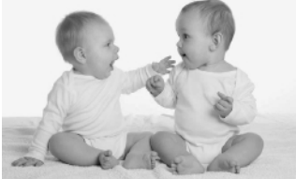
Peer Relationships
Kids are interested in kids
Preferring peers to adults early on and more dramatically with development
Finding appropriate models for their developmental niche
Fundamentally neglected area of research
Unoccupied behavior
Solitary play
Onlooker behavior
Parallel play
Social Play
Associative play
Cooperative play
Notes:
Early interest in form of imitation of acts on objects
By toddler years se social imitation; more likely to imitate peer vs. adult
Interactive exchanges in toddlers are more predictable, more complex, more coordinated and lengthier vs. younger infants

Slide 9
Early development
Infants have rudimentary abilities (to 1 yr)
I.e., increased gazing at peers
Toddlers
Imitate and are aware of being imitated
Have reciprocal relationships with specific kids

Slide 10
Early childhood
Types of play
Unoccupied, solitary, on-looking, parallel, associative, cooperative
Parallel play is important transitional activity
Pretend play emerges (inter-subjectivity)
Friendship emerges
More prosocial and aggressive behavior with friends
As do dominance hierarchies

Slide 11
Peer play examples
sandbox “making butter”, teacher queries
84 seconds https://www.youtube.com/watch?v=Gew1UXw2TGQ
slow-moving tag, three 4-year-olds
90 s https://www.youtube.com/watch?v=32bkyszGg_c
self-organized chalk drawing outside
7 minute ttps://www.youtube.com/watch?v=ZtJ7my7RCnk

Slide 12
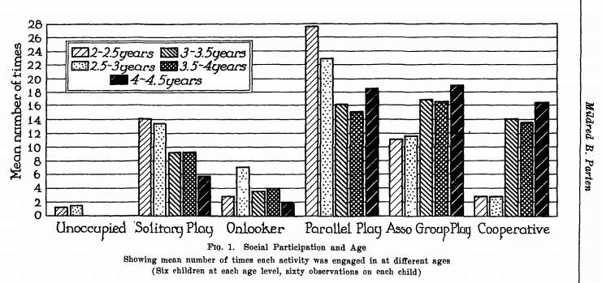
Developmental changes in nature of play behavior (Parten, 1932)
Notes:
Parten – b/w 2 and 5 years kids engage in increasing frequency of associative and cooperative play and less idle, solitary, and onlooker behavior
BUT now know that children of all ages engage in all of these behaviors; even at 5 yrs a considerable amt of time spent in solitary play
Biggest change is the cognitive maturity of different play forms
Increase in solitary construction and solitary exploratory behavs vs. solitary sensorimotor play; social interactions that increase with age include sociodramatic play and games with rules

Slide 13
Martin and Ruble
What age do infants understand gender?
How stable are gender roles?
Maccoby (2002)
Longitudinal studies of gender role stability
Studies suggest some level of stability
Lack of longitudinal data with enough detail
Martin, C. L., & Ruble, D. N. (2010). Patterns of Gender Development Annual Review of Psychology (Vol. 61, pp. 353-381). Palo Alto: Annual Reviews.
Notes:
By 10 months infants able to form stereotypic associations between faces and objects (hammers and scarfs).
18 months they are actively seeking gender behavior information.
Many stereotypes developed by 2 to 3 years of age.
Maccoby argued that gender typing not very stable and it maybe more of a group phenomenon than individual difference.
She concluded examination of individual differences may not be productive.
Studies that utilized a large number of observations over the school year suggested that there is stability but no such studies have been done over a number of years. Further research necessary. This stabiliy could be due to the same classmates and no individual child characteristics.

Slide 14
Gender development
Constructivist argument
Innate gender-specific proclivities
Lead to same sex segregation
Which creates gender-specific socialization
Children create themselves playing with each other
IS THIS POSSIBLE?
Martin, C. L., & Ruble, D. N. (2010). Patterns of Gender Development Annual Review of Psychology (Vol. 61, pp. 353-381). Palo Alto: Annual Reviews.

Slide 15
Implications
Interactions, relationships, and groups are mutually constitutive and have emergent properties
Concepts like popularity exist at an individual and group level

Slide 16
Same-sex groupings
Boys
Larger groups
More conflict/competition
Cohesiveness
More autonomous from adults
Girls
Smaller, more dyadic
Less conflict, more responsive
Less goal-oriented, more intimate
Differential exposure to these groups influences individual behavior

Slide 17
Social networks
6 minutes on slide
https://www.youtube.com/watch?v=Pl3_4D6c8Io
(sociodramatic play – preschool children playing house, pretending to be doggies and kitties)
http://www.youtube.com/watch?v=pdOwvZwiYwk&NR=1
(let’s play kitchen)--Preschool children making hot chocolate—teacher talk
http://www.youtube.com/watch?v=JE9eq3mZhg0&feature=related

Slide 18
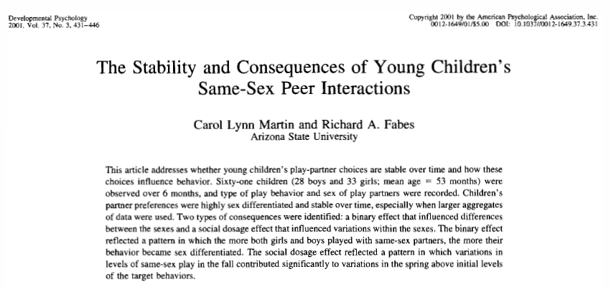

Slide 19
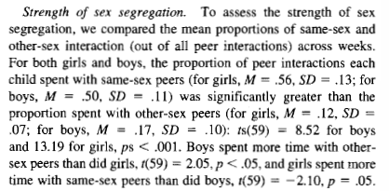
Sex segregation strength at 5 years

Slide 20
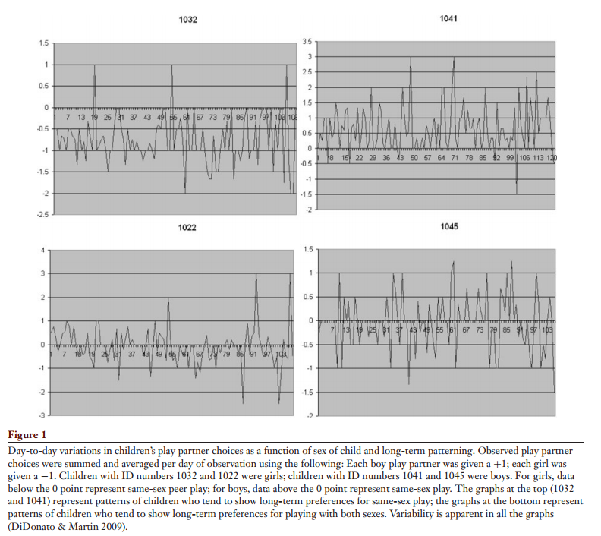
Day-to-day variability
 | Girls | Boys
Same-sex preference
Other-sex preference
Notes:
In Martin & Ruble 2010

Slide 21
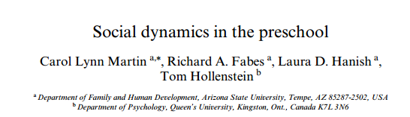
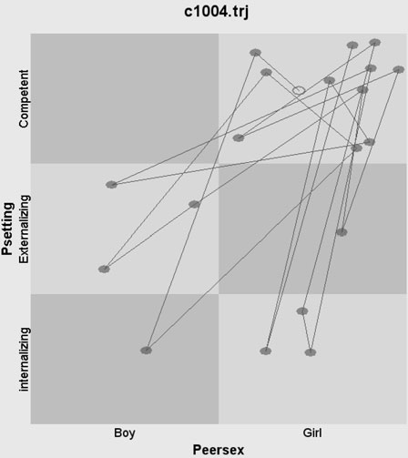
State Space Grids

Slide 22
Dynamic system approach to gender research
Long term changes and short term interactions.
Lynn Martin, C., Fabes, R. A., Hanish, L. D., & Hollenstein, T. (2005). Social dynamics in the preschool. Developmental Review, 25(3–4), 299-327. doi: http://dx.doi.org/10.1016/j.dr.2005.10.001
Notes:
DS approach requires first to identify the variable that represents the system of interest called the collective variable. This variable must be clearly defined and observable. DS have preferred states called attractors that the systems often return to. They can be strong or weak.
Consider all factors and how they operate over time and how they operate in the short run to change the system.
A DS approach to gender segregation would examine all factors social, biological, and biosocial (like temperament). A child's choice of a playmate is limited by which children are available for play. Child form play groups which may evolve into bigger groups and become concrete routine. Small preference differences can lead to large scale segregation between genders overtime.
A socially competent girl’s state space grid, illustrating her patterns of play with
peers of different sexes and different behavioral qualities over the first 20
observed interactions. The x-axis represents the sex of the peer with whom the
target girl interacts; the y-axis represents the behavioral quality of the peers as
determined by clustering teacher ratings of children’s behavior

Slide 23
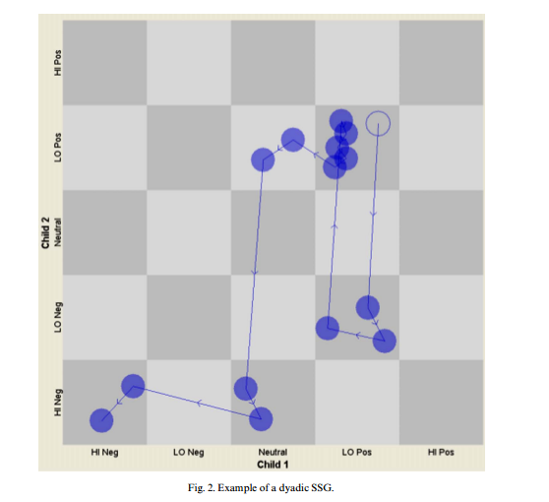
Example of Dyadic SSG

Slide 24
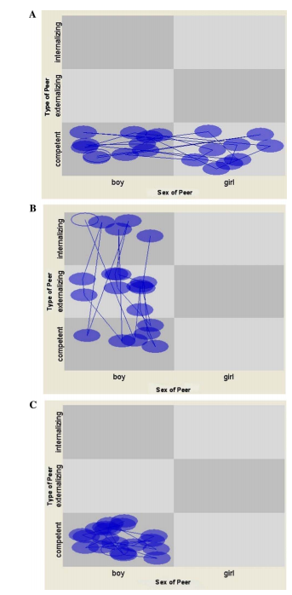
“Fig. 4A represents the state space pattern that might be seen for a socially competent boy who is solely attracted to other socially competent children. “
“Fig. 4B illustrates a pattern based on sex similarity. In this case, the events represented on this boy’s state space illustrate that he is seen interacting only with boys and it does not matter what type of social behavior they tend to display. “
“Fig. 4C depicts the landscape for a socially competent boy whose state space is shaped by both similarity on social behavior and on sex. The events cluster in the region of socially competent boys. If this pattern occurred, it would suggest that behavioral similarity matters but only in consideration for same-sex peers.”

Slide 25
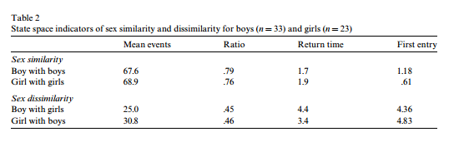
Sex-Segregated Interactions (state space view)

Slide 26
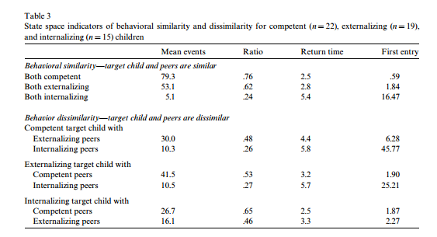
Behaviorally Similar Interactions

Slide 27
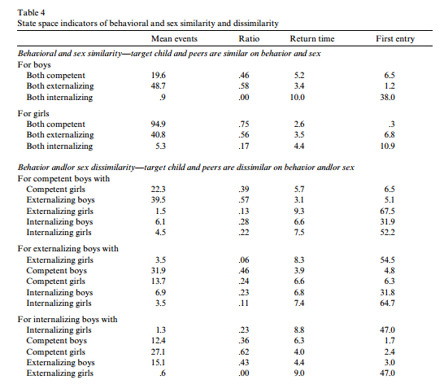
Sex by competence

Slide 28
Design: Observational
Schedule: 2–3 days per week, several hours each day
Structure minimized order effects
Analysis: SIENA modeling framework
Jutagir | Schaefer et al., 2010

Slide 29
How do social networks form?
It’s rare that strangers come together to form new relationships, especially when a researcher is observing.
Preschool presents new social opportunities for children reaching the developmental level that supports enduring peer relationships.
Hypothesis: Well-known principles of network formation, namely reciprocity, popularity, and triadic closure will vary in importance throughout the network formation period as the structure itself evolves.
Structural Cascading: More complex structures evolve from simpler ones.
Jutagir | Schaefer et al., 2010

Slide 30
Network Processes via Siena
Reciprocity: Responding to others’ gestures of friendship with like gestures (Blau, 1964).
Popularity: When individuals with more incoming relations, or ‘ties,’ receive additional friendship initiations at higher rates than others
through preferential attach- ment (Barabási and Albert, 1999) or prefer one another at greater rates (van den Oord et al., 2000).
Triadic Closure: Tendency toward closure, or ‘transitivity,’
an individual’s friends are also friends with one another (Davis, 1970; Hallinan, 1974).
Jutagir | Schaefer et al., 2010

Slide 31
Methods
Participants: 195 children
11 Head Start preschool classrooms, 15-21 children each
Age: 3-5 years (M=4 years)
Race/Ethnicity: Predominantly Hispanic
SES: Low-income
Timeframe: 1 school-year
Design: Observational
Schedule: 2–3 days per week, several hours each day
Structure minimized order effects
Analysis: SIENA modeling framework
Jutagir | Schaefer et al., 2010

Slide 32
Results
Jutagir | Schaefer et al., 2010
Notes:
Reciprocity
As shown in Table 2 (Model 1), the positive effect of reciprocity indicated that children were more likely to form ties to alters who preferred ego as a play partner.
Reciprocity was thus an important predictor of ties from the first period onward and at about the same level throughout the school year
Popularity
In-degree related popularity captures whether children become more attractive as friends as their number of incoming ties increases.
Model 2 reveals a significant, positive main effect, indicating an increased likelihood of forming ties with popular children relative to less popular children. We expected popularity to become more important over time as relationships emerged and the network stabilized. The interaction between popularity and the linear period term is positive and the score test indicates it significantly improves model fit. Thus, popularity became increasingly important throughout the year. Because it takes time for relationships to form and for the unequal distribution of incoming ties that is the basis for popularity to form, popularity has a greater tendency to shape relationships later in the year.
Triadic Closure
Transitivity
- Transitivity produces triadic closure when (1) what was previously an indirect connection from i to k through j becomes direct through the addition of a tie from i to k or (2) i and j both have ties to k, and i adds a tie to j. The transitive triplets effect in SIENA counts the number of closed triads in which ego is in position i. The positive main effect suggests that children were more likely to select others as play partners when those ties increased the num-ber of transitive patterns in the network (Model 3). The significant positive interaction between transitive triplets and period indicates that transitivity became more important over time. Throughout the year, children became increasingly likely to form relationships with the friends of current friends.
2) Dense triads
- We measured dense triads as whether or not all six of the possible ties among three children existed. Model 4 reveals a significant positive main effect of dense triads and a significant interaction with period. The positive effect of dense triads indicated that relationships that created closed triads, where all of the relationships were reciprocal, were more likely to form than relations that did not produce dense triads. Moreover, the importance of the effect of dense triads increased over the course of the year. As the network stabilized and relationships strengthened during the year, dense triads became increasingly common.

Slide 33
Reciprocity, Popularity, Triplets
Jutagir | Schaefer et al., 2010

Slide 34
Change over year
(Density of triads = # of existing ties relative to possible #→reciprocation.)
Jutagir | Schaefer et al., 2010

Slide 35
Structural cascading observed
‘Reciprocity effects peak early, when children first enter the school and form new relationships. As children form relationships, reciprocity effects remain constant.
As relationships strengthen, children become more likely to seek and maintain relationships with popular peers. Popularity peaks in importance midway through the school year.
Unlike popularity, triadic closure increases in importance over the year, peaking in the final period. Children become increasingly likely to form strong, closed triads composed of mutual friendships.”
Children increasingly exposed to children with whom their friends are playing. …
Jutagir | Schaefer et al., 2010
Notes:
effects on relationship formation and change. However, in addi- tion, we found support for the hypothesis that structural effects “cascade” in importance over time, from the simple to the more complex. Thus, we echo Doreian et al.’s (1996) assertion that net- work processes proceed on different timescales.

Slide 36
The social networks of children with and without disabilities in early childhood special education classrooms
Chen, Lin, Justice, & Sawyer (2017)

Slide 37
Background
Interactions with peers foster social and cognitive development
Interactive peer play positively influences children’s spatial reasoning skills, self-regulation, social learning competencies, and knowledge of emotion.
Inclusive Classrooms
Advantages
Strengthen learning and development
Learn from age-appropriate models
Experience collaboration and teamwork
Disadvantages
Increase risk of isolation/rejection
Increase chance of being bullied

Slide 38
Objectives and Hypotheses
To examine peer interactions within Early Childhood Special Education (ESCE) inclusive classrooms using a social network analysis approach.
Hypotheses:
Play interactions: Children with disabilities < Typically developing
Conflict interactions: Children with disabilities > Typically developing
Disability homophily effect

Slide 39
Participants
Data collected from 64 Early Childhood Special Education (ECSE) inclusive classrooms
Evenly distributed across geographical locations
485 preschool children (Age Range: 34-70 months)
Disability Status:
Typically Developing (n = 293)
Have at least one disability (n = 192)
Language impairment, developmental delay, multiple disabilities, autism, emotional disturbance, orthopedic or other health impairment, visual or hearing impairment, specific learning disability, no diagnosis available

Slide 40
Measures
Classroom play and conflict networks
Based on teacher ratings
Play: (0 = Never play together, 4 = Always play together)
Engaging in pretend play
Giving and sharing toys
Exploring object together
Collaborating on building blocks
Conflict: (0 = Never have conflict, 4 = Always have conflict)
Quarreling/fighting
Kicking/hitting
Shouting
Language ability:
Clinical Evaluation of Language Fundamentals Preschool (CELF)
Expressive vocabulary, sentence structure, word structure

Slide 41
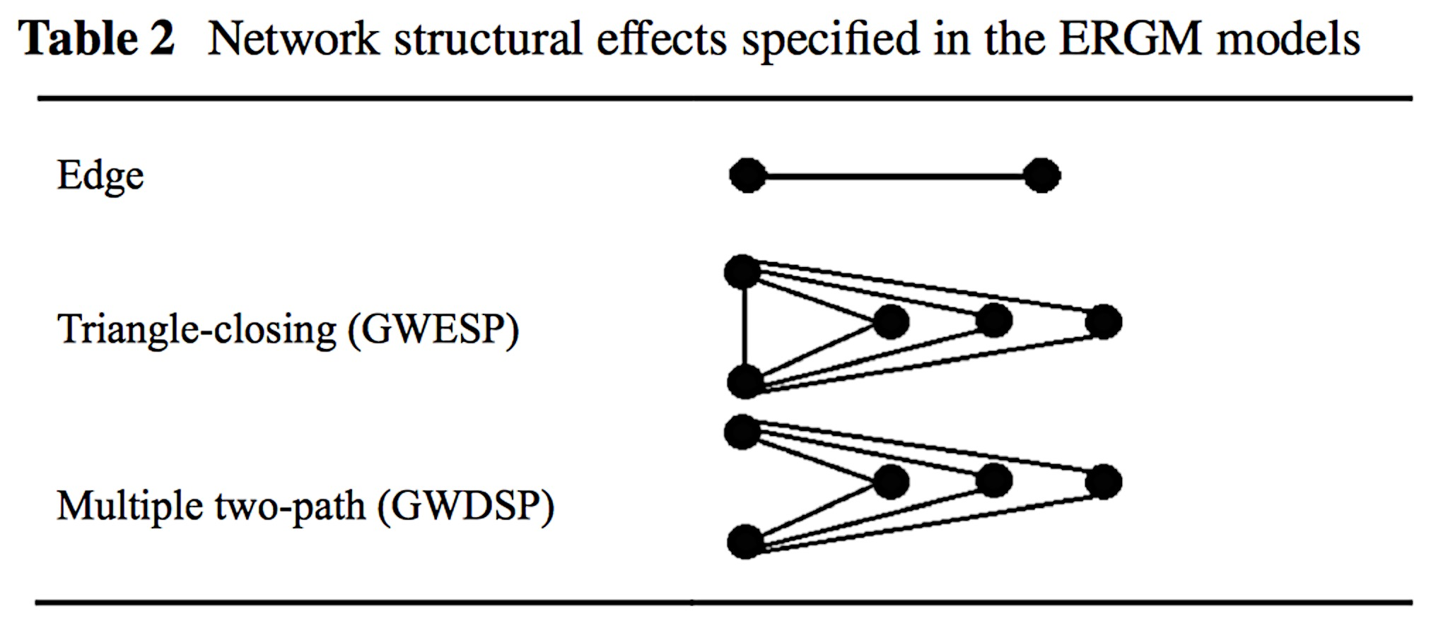
Network approach
Descriptive social network indices:
Individual degree centrality (child-level index)
Network density (classroom-level index)
Exponential Random Graph Models (ERGMs):
Actor covariate effects
Disability main effect
Disability homophily effect
Network structural effects
Edge
Triangle-closing
Multiple two-path

Slide 42
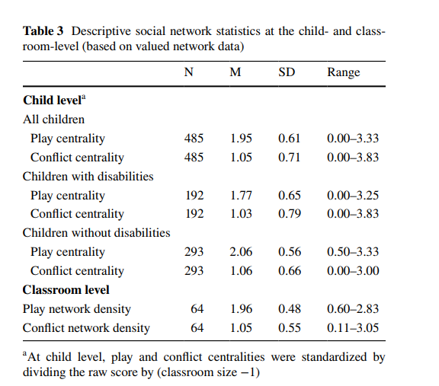
Kids with disabilities -- lower play centrality. No difference in conflict play centrality
On average, children “sometimes” played with peers and “rarely” had conflicts with peers
Children with disabilities had significantly lower play centrality. No significant difference in conflict play centrality
Notes:
0-4 scale
1 – never
1 – rarely
2 – sometimes
3 – often
4 – always
Children with disabilities formed looser play networks but similar conflict networks

Slide 43
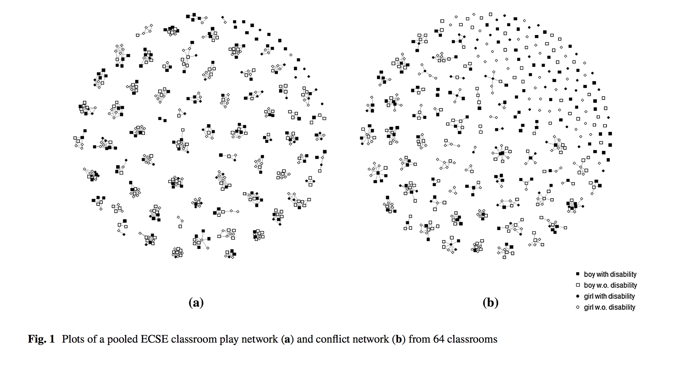
Results

Slide 44
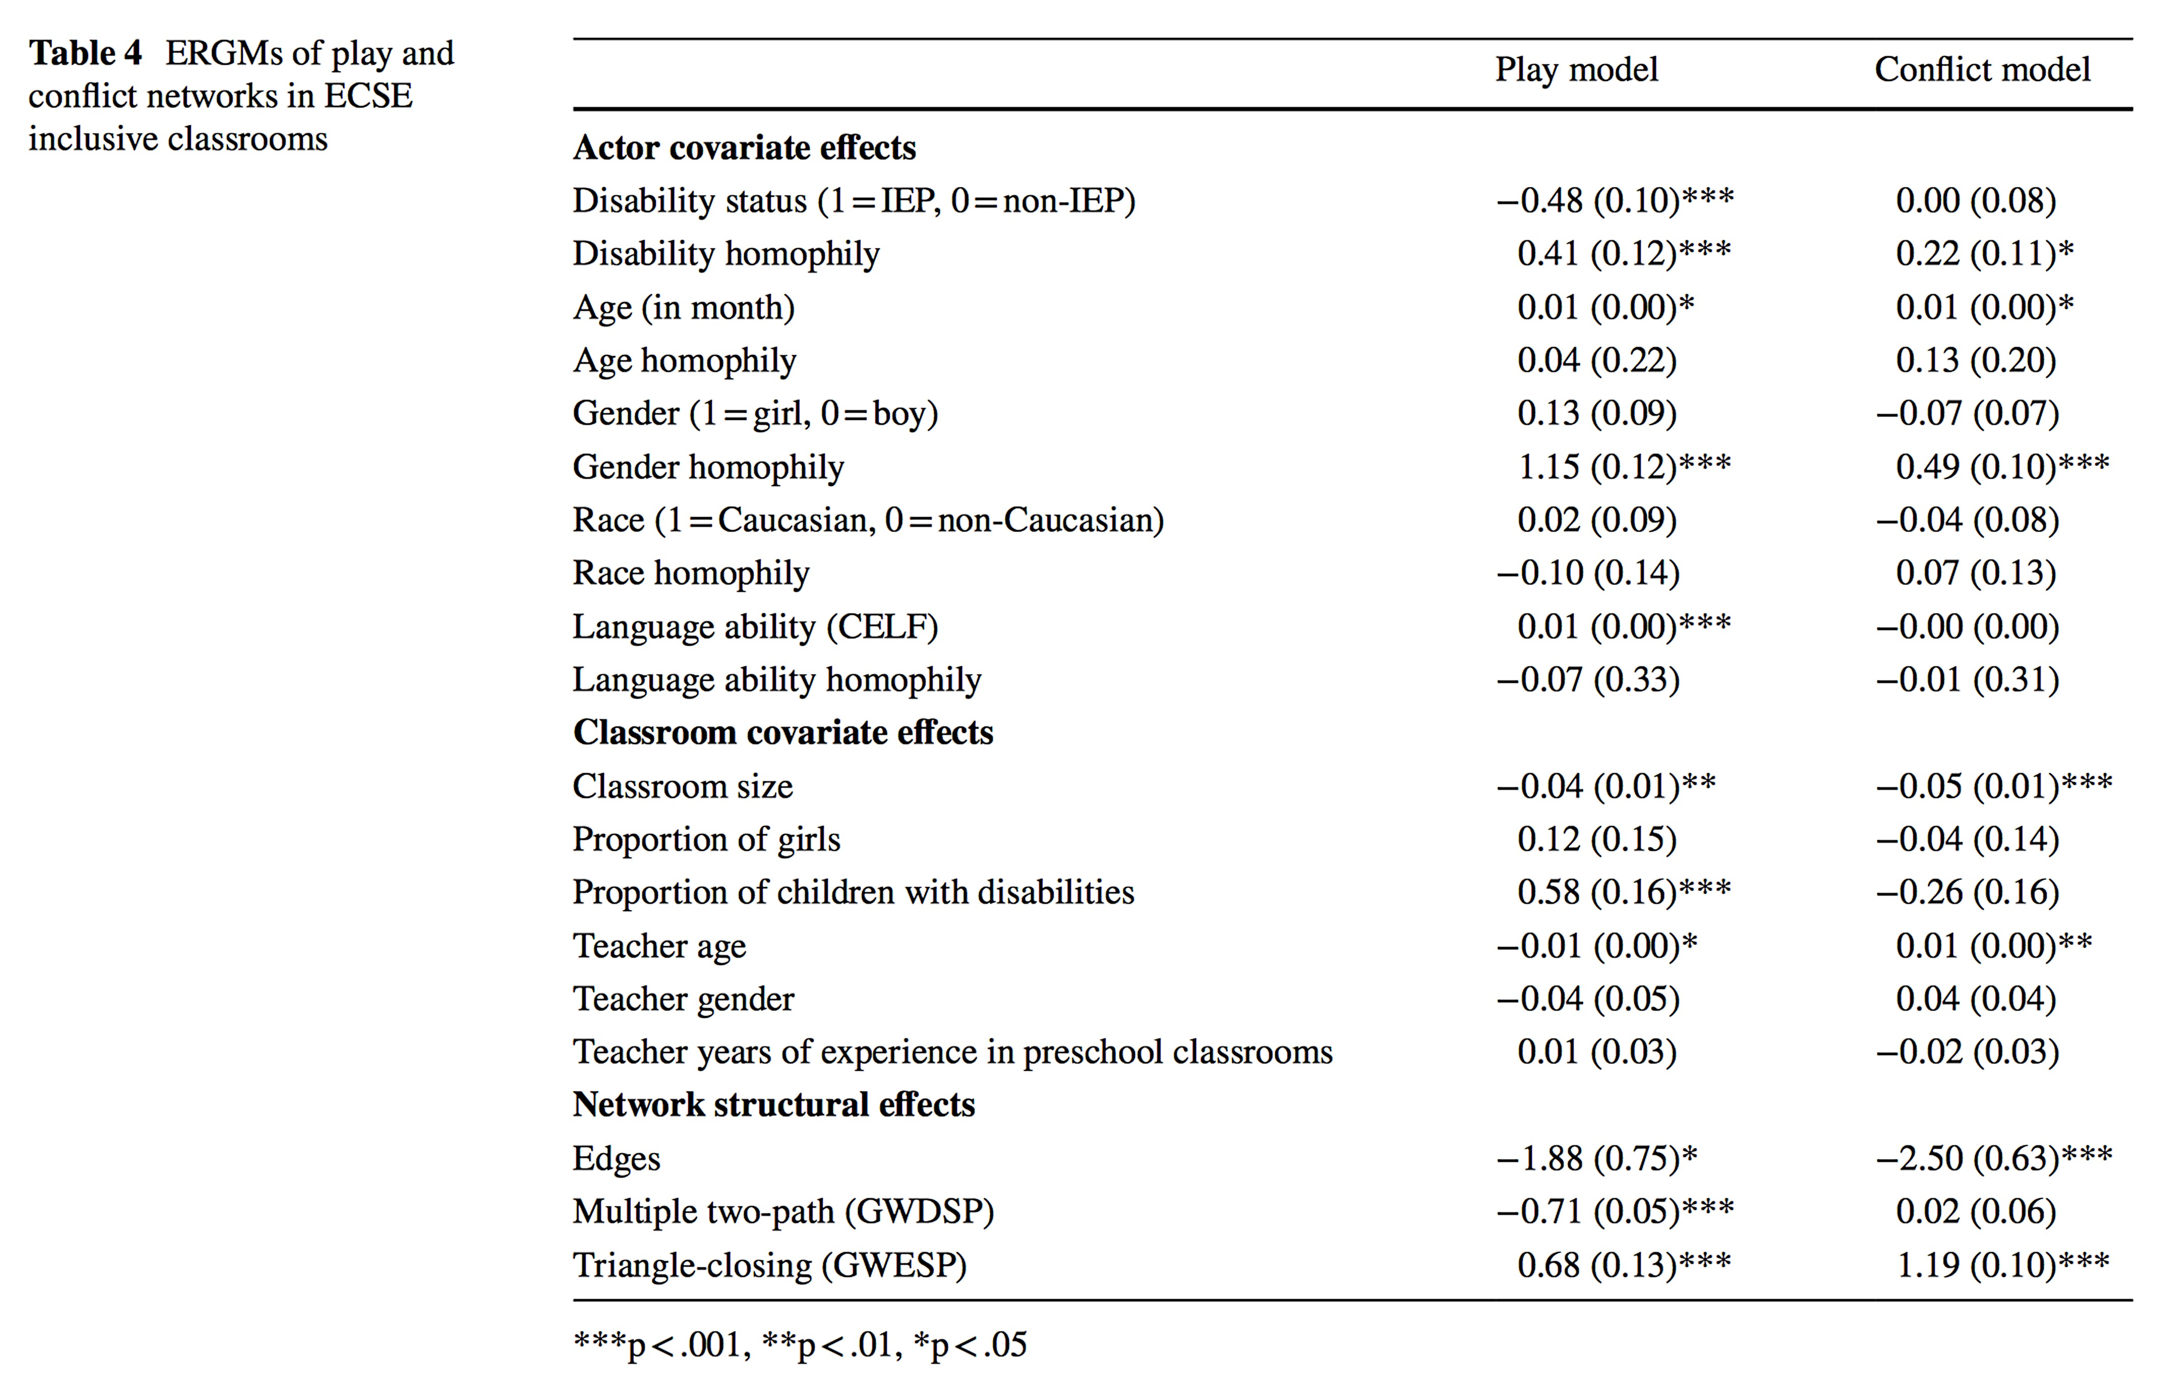
Disability: status and homophily
Children with disabilities are less likely to interact with peers in their play network but are equally likely to engage in conflict vis-à-vis typically developing peers.

Slide 45
Summary of Findings
Children with disabilities are less likely to interact with peers in their play network but are equally likely to engage in conflict vis-à-vis typically developing peers.
Evidence of segregation based on disability status in both play and conflict networks.
May be attributable to differences in social skills, self-expectation, and competence.

Slide 46
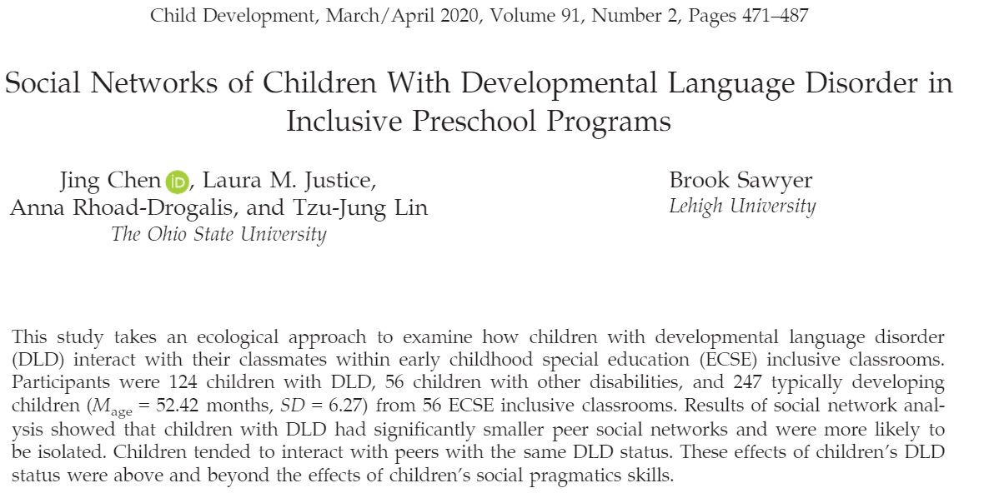
Rating scale (0 = never,1= rarely play,2= sometimes play,3= often play,4= always play)

Slide 47
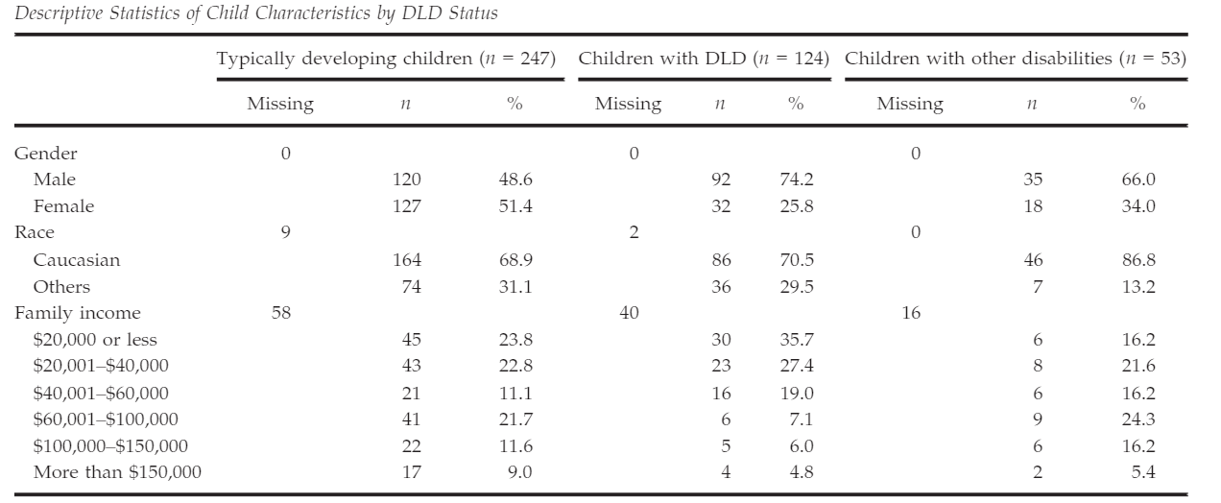
Children with DLD and children with other disabilities
Rating scale (0 = never,1= rarely play,2= sometimes play,3= often play,4= always play)

Slide 48
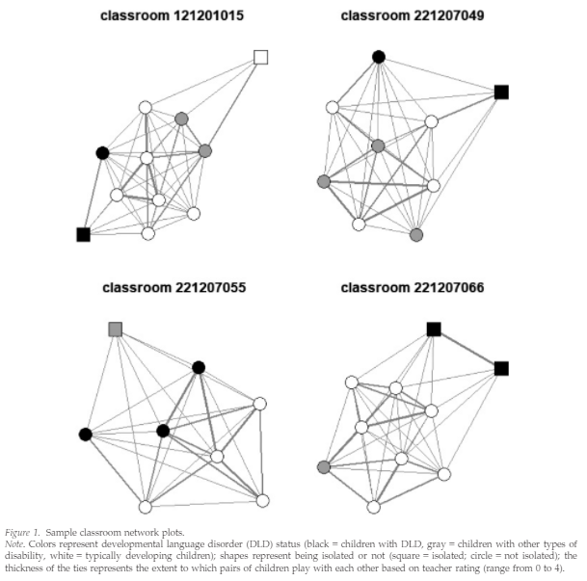
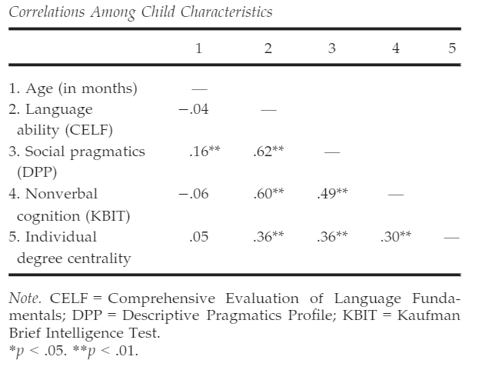
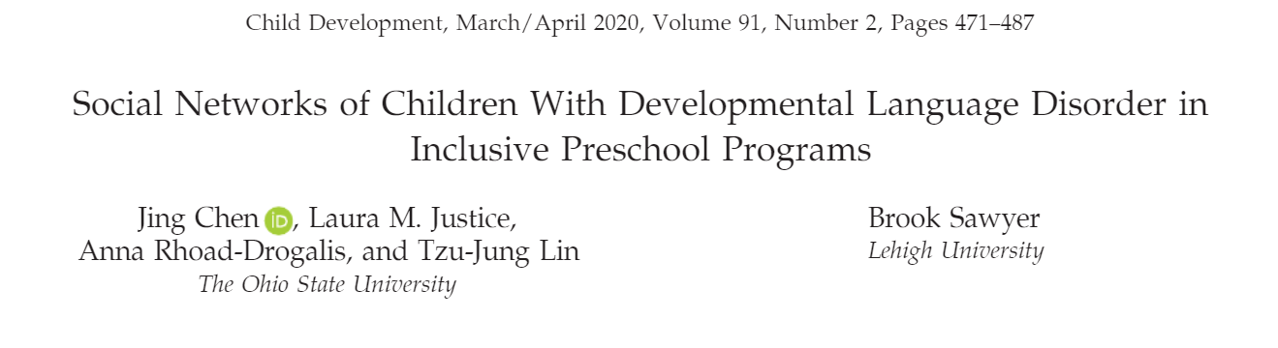

Slide 49
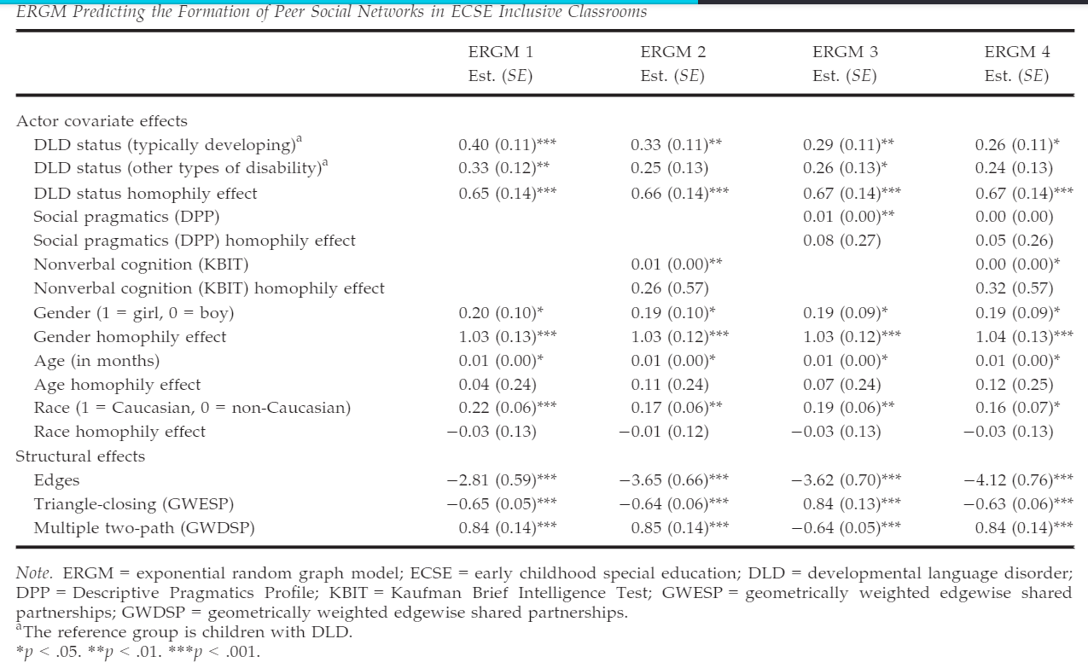
Predicting edges: Disability status and homophily, with covariates

Slide 50
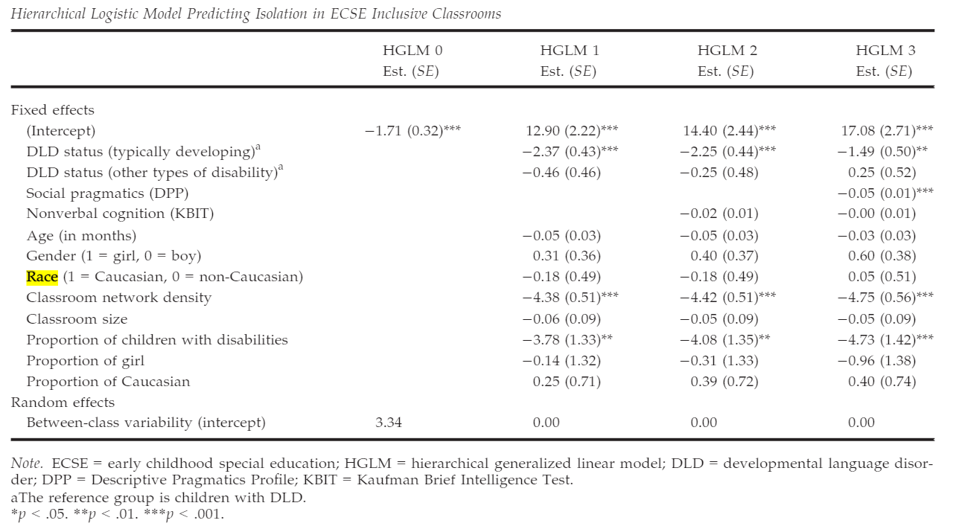
Predicting isolation: Disability status and homophily, with covariates

Slide 51
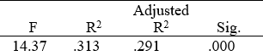

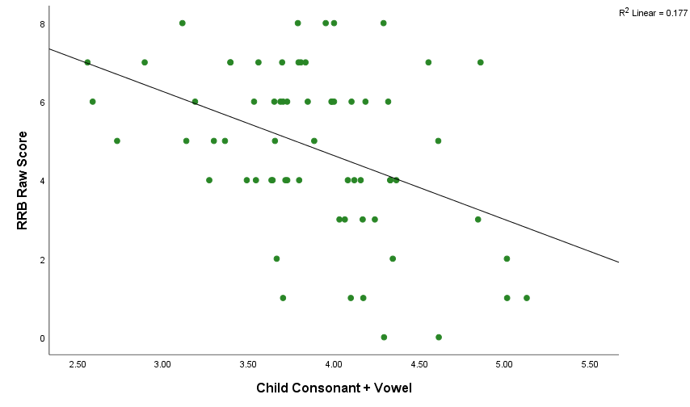
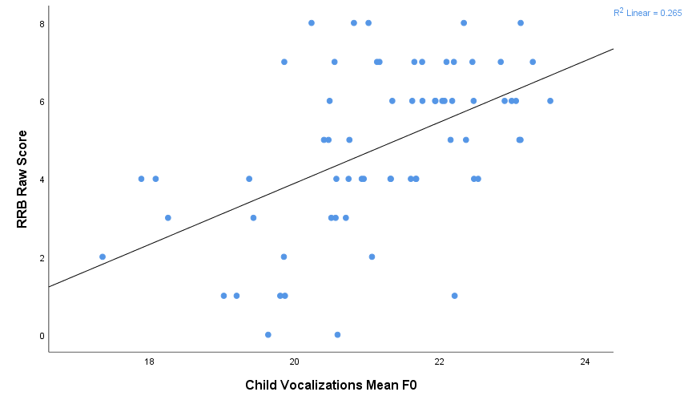
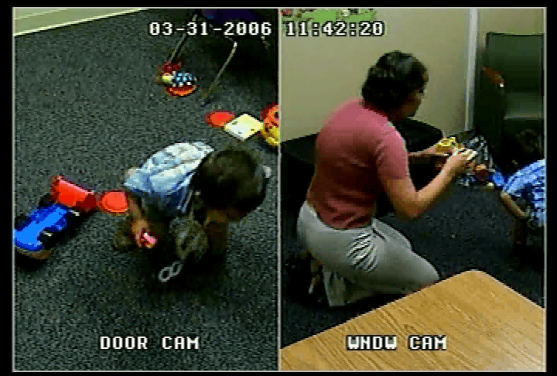
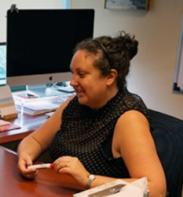
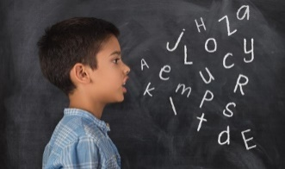
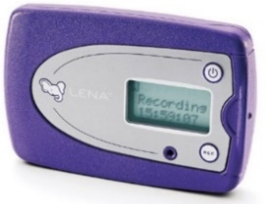
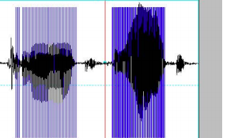

Objective behavior measures to facilitate development
Child vocalizations in the clinic predict autism severity
r = -.42, p < .01
r =.51, p < .01
Moffitt, 2021
Moffitt, Perry,
Messinger,
et al., 2021
Vocal Complexity
Frequency (Pitch)

Slide 52
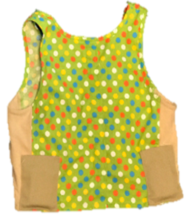
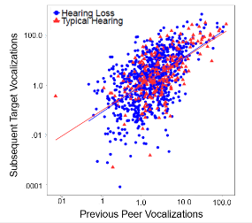
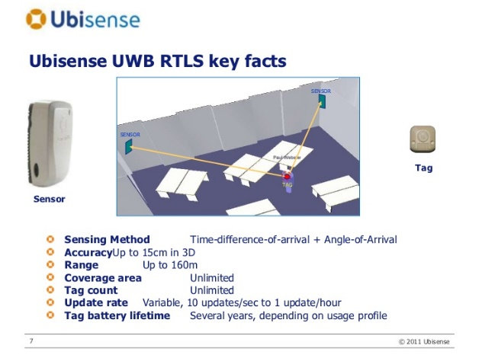
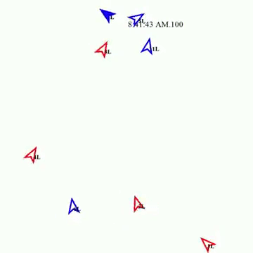

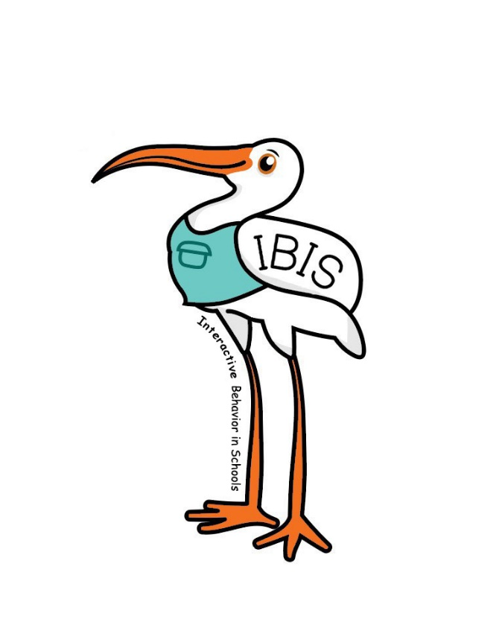
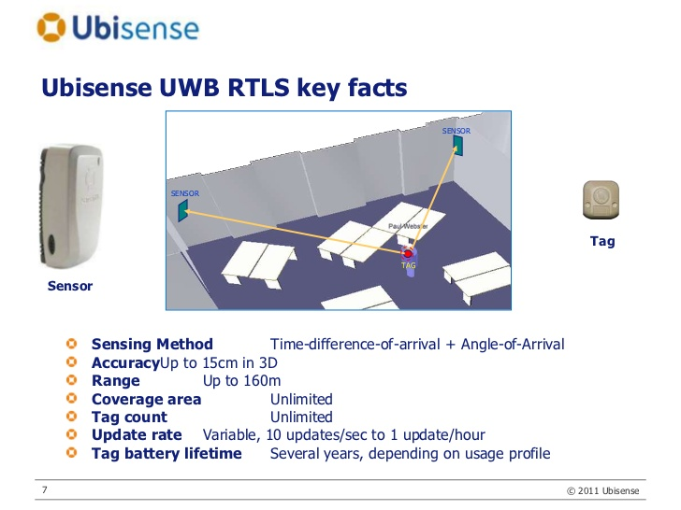

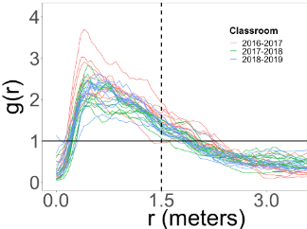

Interactive Behavior in Schools (IBIS)
What do we collect?
How do we collect this?
Hiring a data
scientist postdoc!

Slide 53
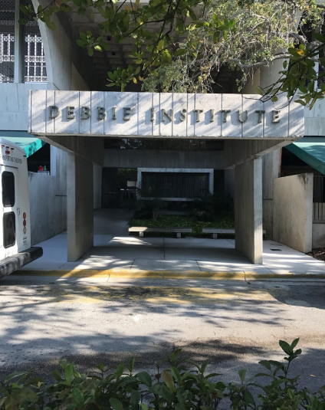

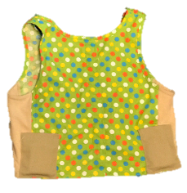

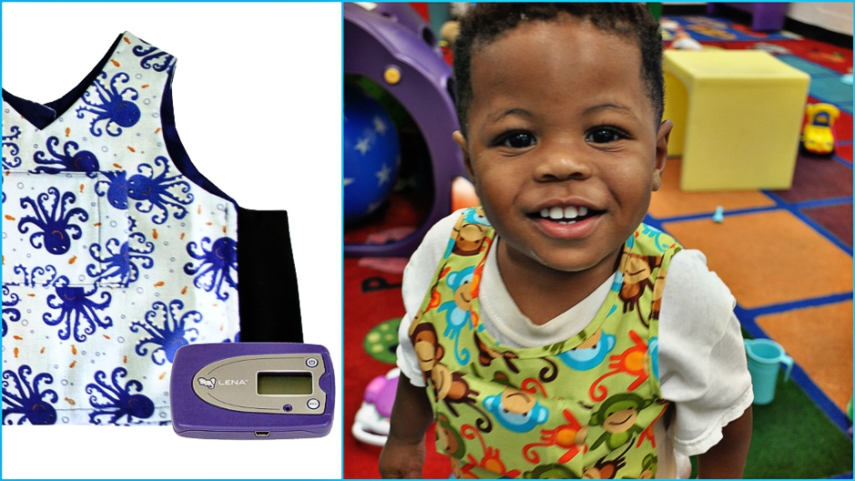
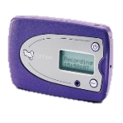

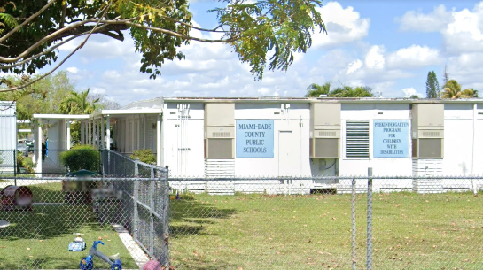
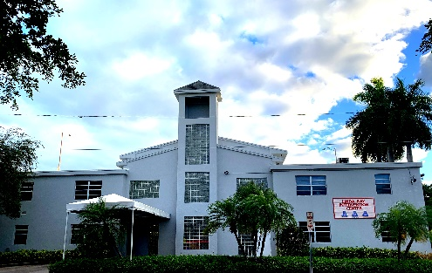
Real world preschool data/collaborations
LENA helps us know how much children talk
Ubisense helps us know where children are/who they are talking to

Slide 54
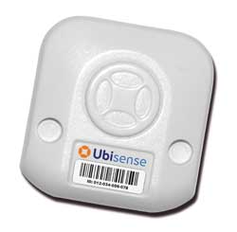

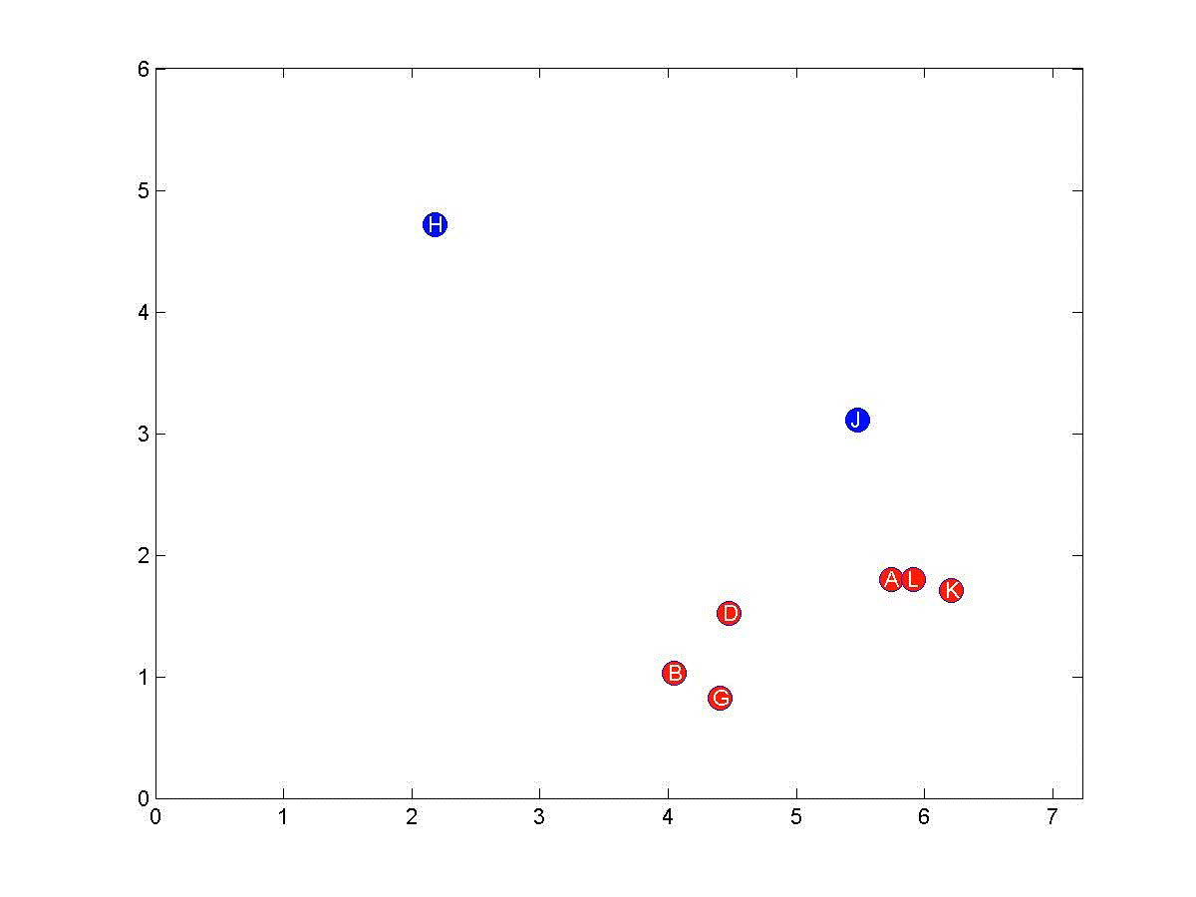
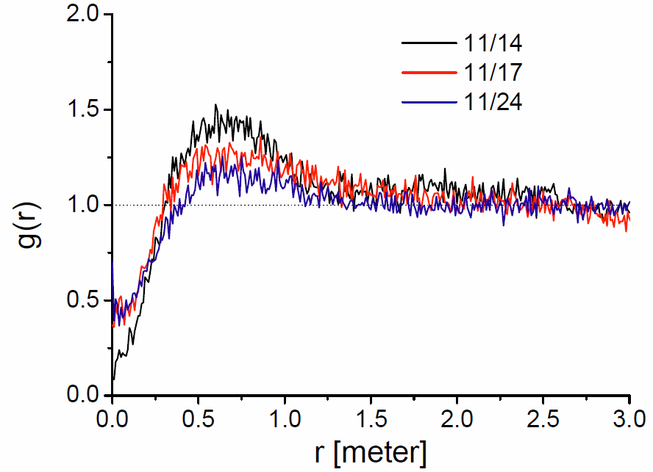


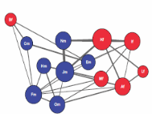
RFID location tracking (kindergarten)
Objective observation
Detecting social contact g (r)
Udo Rudolph
Chaoming Song
Messinger, Song, Perry, et al., 2019

Slide 55
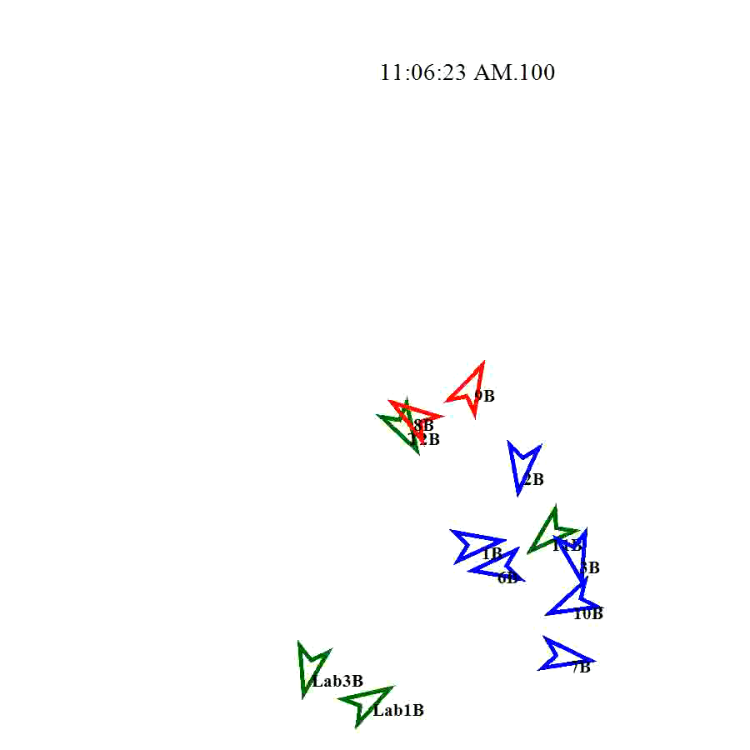




Social contact: Inferring interaction
Data
Distance
Orientation
Perry, et al. (2019)
Chaoming Song
Messinger, et al. 2018

Slide 56





Partner vocalizations predict child vocalizations
Deaf/Hard-of-hearing
classroom
Child to child vocalizations
Teacher to child phonemes
Perry, et al., 2021
IDSC Fellow,
Mitsven, et al., 2020
B=.33, se=.08, t=4.02, X²(1)=15.71, p=.00007
Regardless of a child’s hearing status

Slide 57
Phoneme types: Teacher → Child
Typical hearing > hearing loss
IDSC Fellow,
Mitsven, et al., 2020

Slide 58




Adult phoneme → child phoneme → child language score
Mitsven, et al., 2020

Slide 59





Autism (ASD) classrooms
Distance
0.2m – 2m
Orientation
+/- 45 degrees

Slide 60






Lower ASD Network Modularity
Reduced ASD
Modularity
& Between
Modularity
lmer(Modularity ~ Eligibility Group + Observation Day + (1|Class))
Fasano, et al., 2019

Slide 61




Reduced ASD degree centrality → language abilities
Centrality: ps < .026, ASD/TD: ps < .015, ASD/DD: ps > .05

Slide 62



Concordant social contact in autism inclusion classrooms
IDSC Fellow,
Banarjee, et al.,
2021

Slide 63
Bullying as a classroom phenomenon
Not just an individual (the bully)
Not just a dyad (bully and victim)
“Bullying more likely in classrooms characterized by poor climate, strong status hierarchy, and pro-bullying norms.
Bystanders’ responses contribute by rewarding or sanctioning the behavior of the perpetrators.
Bullying functions not only for individual perpetrators but for the whole peer group by providing a common goal and a semblance of cohesion.
Saarento, S., & Salmivalli, C. (2015). The Role of Classroom Peer Ecology and Bystanders’ Responses in Bullying. Child Development Perspectives, 9(4), 201-205. doi: 10.1111/cdep.12140

Slide 64




Three preschool classrooms that included children with hearing loss (HL) and typically hearing (TH) children between 2.5 and 3.5 years of age participated.
(N = 29, 16 girls, 14 Hispanic)
Vocalization data were collected over 34 total observations.
Note. HA – Hearing Aid; CI – Cochlear Implant. *One child had both a CI and HA.

Slide 65
The rate and phonemic diversity of teachers’ utterances did not differ by children’s hearing status
b = -.04, X² = .01, p = .910
b = .16, X² = .52, p = .472

Slide 66
Children with hearing loss produced fewer & less phonemically diverse utterances than typically hearing peers
b = 1.22, X² = 4.26, p = .039
b = 1.49, X² = 13.95, p < .001

Slide 67
The quantity and quality of teacher speech predicted the quantity and quality of child speech, but...
b = .14, X² = 8.97, p = .003
b = .20, X² = 22.84, p < .001

Slide 68
But phonemic diversity of children’s speech more strongly predicted language abilities than the rate of their speech.
 | Model Outcome | Step and predictor | R² | ΔR² | df | p
Model 1A | Receptive language ability | 1. Child phonemic diversity | .353 | .353 | 1, 24 | .001
 |  | 2. Child rate | .395 | .042 | 1, 23 | .218
Model 1B | Receptive language ability | 1. Child rate | .263 | .263 | 1, 24 | .007
 |  | 2. Child phonemic diversity | .395 | .132 | 1, 23 | .035
Model 2A | Expressive language ability | 1. Child phonemic diversity | .352 | .252 | 1, 24 | .001
 |  | 2. Child rate | .383 | .031 | 1, 23 | .294
Model 2B | Expressive language ability | 1. Child rate | .239 | .239 | 1, 24 | .011
 |  | 2. Child phonemic diversity | .383 | .144 | 1, 23 | .030

Slide 69
Adult phoneme → child phoneme → child language score

Slide 70
Children who produced more phonemically diverse utterances had higher end-of-year language abilities.
b = 33.26, SE = 12.56, t = 2.65, p = .015
b = 24.37, SE = 10.22, t = 2.38, p = .026

Slide 71
In fact, the phonemic diversity of children’s speech mediated the relationship between the phonemic diversity of their input and their language abilities.

Slide 72

Changing climates of conflict: A social network experiment in 56 schools
Paluck, E.L., Shepherd, H., & Aronow, P.M., 2015
Roddy, 2017

Slide 73
How to influence change?
Change the individual–focus in psychology
Mass education at community level
Seed social networks within individuals
Social norms emerge when
Support survival of the group
Arbitrary historical precedent
Once established, survive by punishment of deviants and success of followers
Paluck et al., 2015 | Roddy, 2017

Slide 74
Definitions
Conflict: “antagonistic relations or interactions, or behavioral opposition, respectively, between two or more social entities” (pg. 2, Paluck et al., 2015)
Bullying
Conflict among equals
Social Referent: “their behavior is observed by many other individuals” (pg. 2, Paluck et al., 2015)
Different from popularity or friendship – not necessarily observed behavior
More likely to date someone at the school
Receive compliments from peers
Have older siblings
Paluck et al., 2015 | Roddy, 2017

Slide 75
Method
Randomly selected groups of 20–32 students from randomly selected schools assigned to intervention that encouraged their public stance against conflict.
Conflict Measured via:
Survey of students
Administrative disciplinary reports on peer conflict
Paluck et al., 2015 | Roddy, 2017

Slide 76

Changing climates of conflict: A social network experiment
Randomly selected groups of 20–32 students from randomly selected schools assigned to intervention that encouraged their public stance against conflict.
Disciplinary reports of student conflict at treatment schools reduced by 30% over 1 year.
56 schools with 24,191 students.

Slide 77
Disciplinary reports of student conflict at treatment schools reduced by 30% over 1 year
56 schools with 24,191 students.
Paluck et al., 2015 | Roddy, 2017

Slide 78

Treatment vs. control schools by % social referent seeds
Lines ~ conditional average potential outcome with respect to the proportion of social referent seeds
2. Stronger effect when seed group contained more “social referent” students who, as network measures reveal, attract more student attention.
n.s.
Paluck et al., 2015 | Roddy, 2017

Slide 79

Mixed Results
Predicted in graph means from L → R
No exposure from seed or school
Treatment school, no exposure to seed student
Exposed to non-referent seed student
Exposed to social referent seed student
n.s.
Paluck et al., 2015 | Roddy, 2017

Slide 80
Discussion
Alternative hypothesis for why the perceived norm against social conflict was lower in SR seed exposed students? (Figure 3 B)
Why do the results show a change in social context, but not for peer-to-peer conflict in school reported discipline? (Figure 4 D)
This study was about a negative behavior (conflict); would the results look different for positive change (e.g. healthy eating)?
Paluck et al., 2015 | Roddy, 2017

